Slide 2
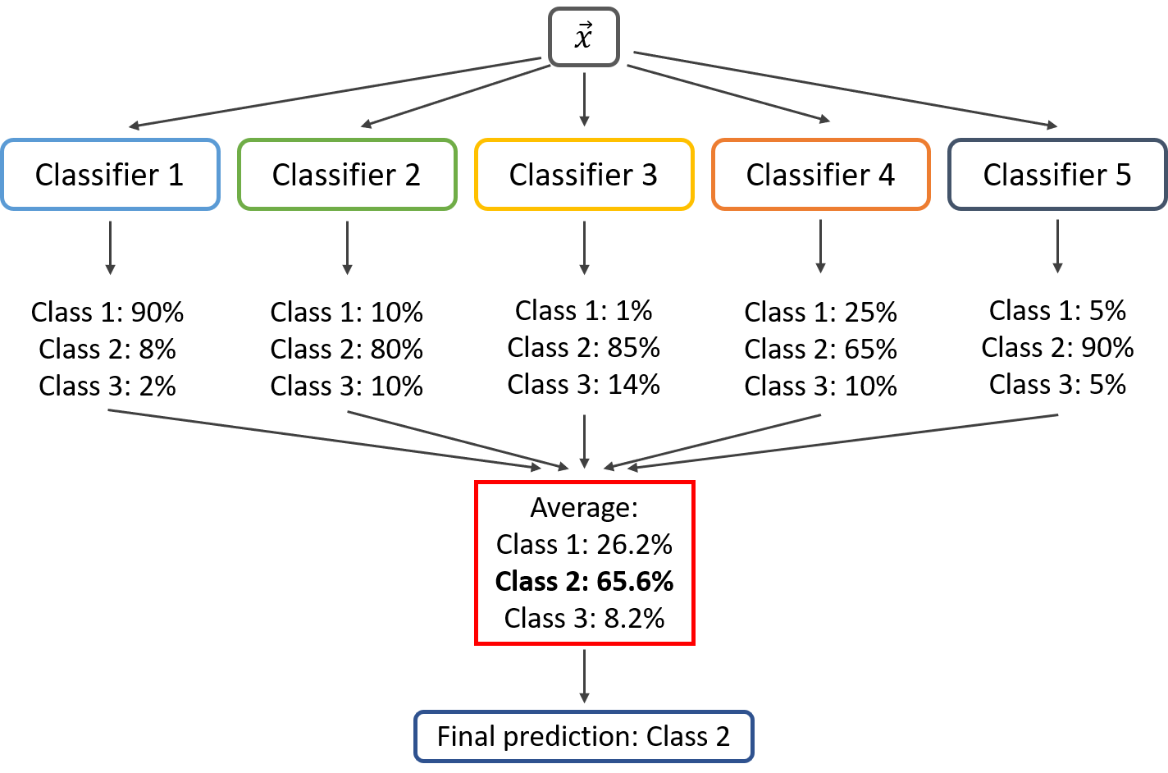

Slide 6




Slide 7
Hierarchical Clustering
Outputs a hierarchy, a structure that is more informative than the unstructured set of clusters returned by flat clustering
B
C
B
C
B
C
B
C
A
A
A
A
D
D
D
D
F
E
F
E
F
E
F
E
Dissimilarity
Dissimilarity
Dissimilarity
Dissimilarity
A B C D E
A
B C D E F
A B C D E F
Combination of D and E is combined with F
A B C D E F
Final tree contains all clusters Combined into a single cluster
Combine A and B based on similarity Combine D and E based on similarity
Combination of A and B is combined with C
1
2
3
4

Slide 8

Working: Hierarchical Clustering
Step 1
Step 2
Step 3
Step 4
Assign each item to its own cluster, such that if you have N number of items, you now have N number of clusters
Find the closest (most similar) pair of clusters and merge them into a single cluster. Now you have one less cluster
Compute distances (similarities) between the new cluster and every old cluster
Repeat steps 2 and 3 until all items are clustered into a single cluster of size N

Slide 9
Distance Measures
Complete - Linkage clustering
Find the maximum possible distance between points belonging to two different clusters
Single - Linkage Clustering
Find the minimum possible distance between points belonging to two different clusters
Mean - Linkage Clustering
Find all possible pair-wise distances for points belonging to two different clusters and then calculate the average
Centroid - Linkage Clustering
Find the centroids of each cluster and calculate the distance between them

Slide 10

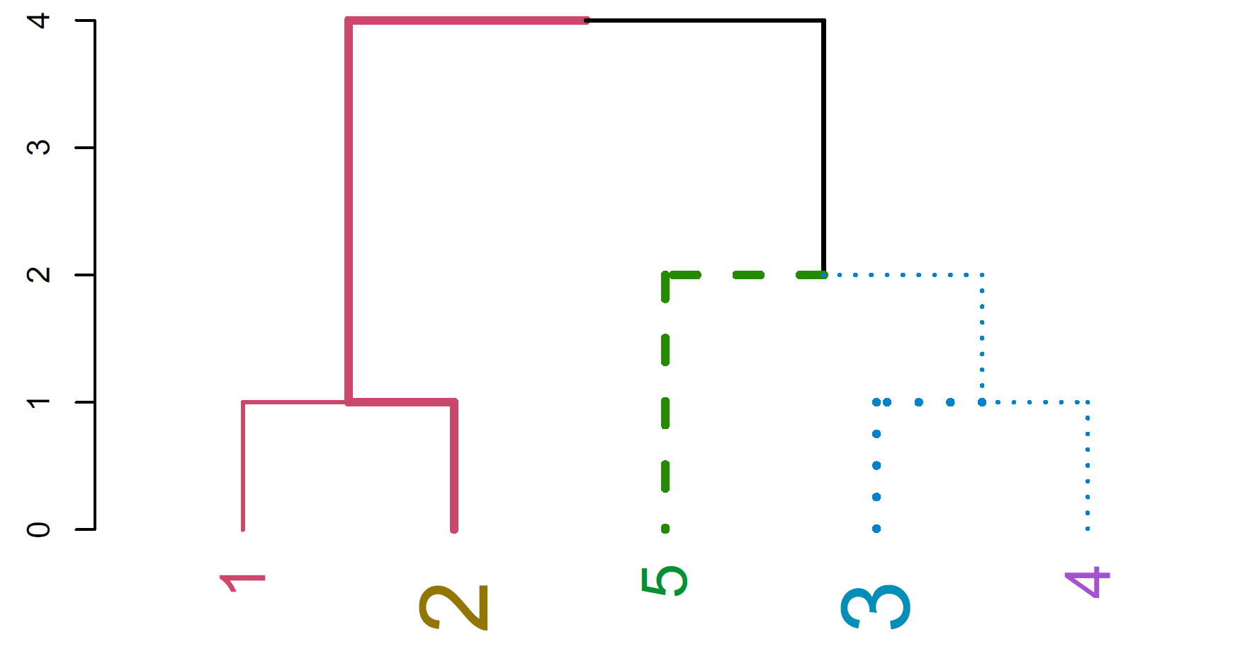
The Dendrogram
Dendrogram ((in Greek, dendro means tree and gramma means drawing) is a tree diagram frequently used to illustrate the arrangement of the clusters produced by hierarchical clustering.
Agglomerative
Divisive

Slide 11
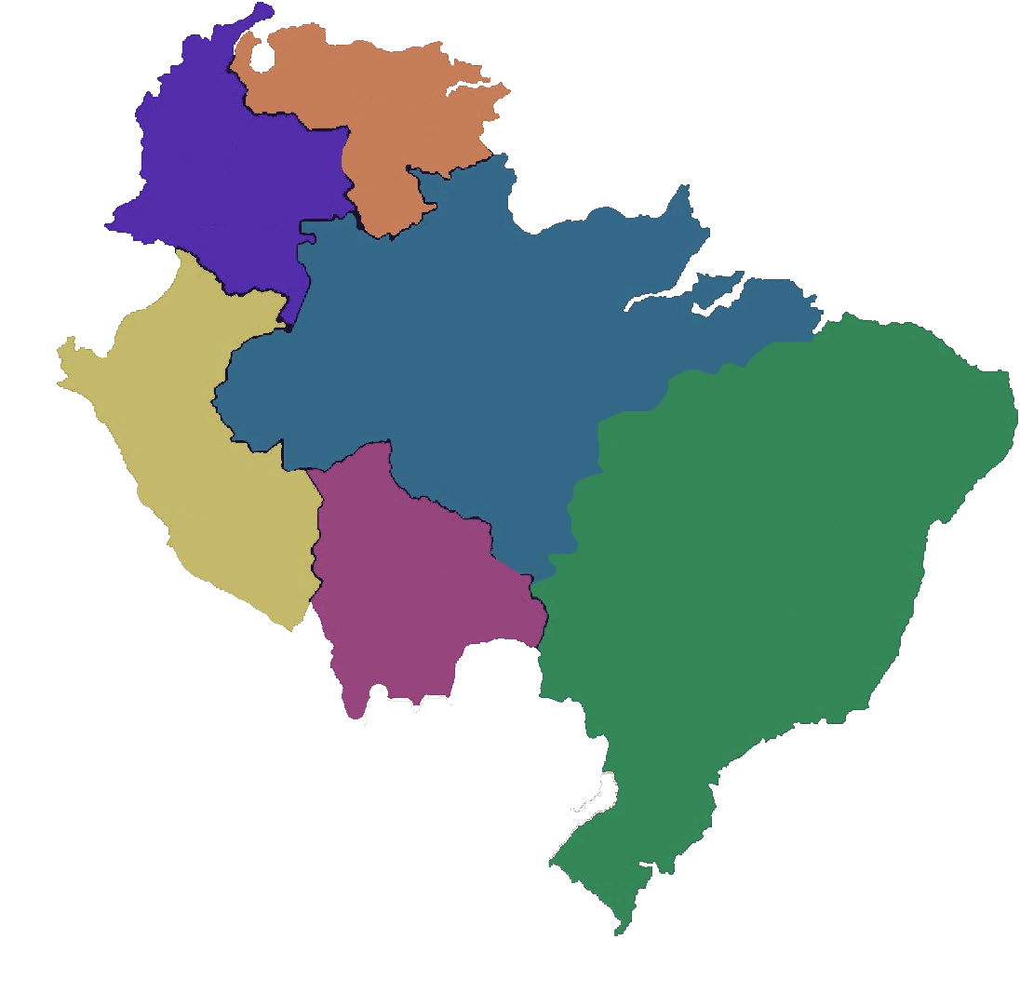














Hierarchical Clustering: Example
A hierarchical clustering of distances between cities in kilometers
MI
TO
FI
RM
NA
BA
BA
NA
RM
RM
FI
TO
MI

Slide 12

Hierarchical Clustering: Step 1
Create distance matrix of data
 | BA | FI | MI | NA | RM |  | TO
BA | 0 | 662 | 877 | 255 | 412 |  | 996
FI | 662 | 0 | 295 | 468 | 268 |  | 400
MI | 877 | 295 | 0 | 754 | 564 |  | 138
NA | 255 | 468 | 754 | 0 | 219 |  | 869
RM | 412 | 268 | 564 | 219 | 0 |  | 669
TO | 996 | 400 | 138 | 869 | 669 |  | 0
Distance between TO and MI
Distance Matrix

Slide 13


Hierarchical Clustering: Step 2
From the distance matrix, you can see that MI has least distance with TO and they form a cluster together
 | BA | FI | MI | NA | RM | TO
BA | 0 | 662 | 877 | 255 | 412 | 996
FI | 662 | 0 | 295 | 468 | 268 | 400
MI | 877 | 295 | 0 | 754 | 564 | 138
NA | 255 | 468 | 754 | 0 | 219 | 869
RM | 412 | 268 | 564 | 219 | 0 | 669
TO | 996 | 400 | 138 | 869 | 669 | 0
 | BA | FI | MI/TO | NA | RM
BA | 0 | 662 | 877 | 255 | 412
FI | 662 | 0 | 295 | 468 | 268
MI/TO | 877 | 295 | 0 | 754 | 564
NA | 255 | 468 | 754 | 0 | 219
RM | 412 | 268 | 564 | 219 | 0
TO
MI
As the MI column has lower values than TO column, MI/TO consists of MI column values

Slide 14




Hierarchical Clustering: Step 3
Repeat clustering until a single cluster is obtained with all the members in it
 | BA | FI | MI/TO | NA | RM
BA | 0 | 662 | 877 | 255 | 412
FI | 662 | 0 | 295 | 468 | 268
MI/TO | 877 | 295 | 0 | 754 | 564
NA | 255 | 468 | 754 | 0 | 219
RM | 412 | 268 | 564 | 219 | 0
NA RM TO MI
 | BA | FI | MI/TO | NA/RM
BA | 0 | 662 | 877 | 255
FI | 662 | 0 | 295 | 268
MI/TO | 877 | 295 | 0 | 564
NA/RM | 255 | 468 | 564 | 0

Slide 15




Hierarchical Clustering: Step 3 (Contd.)
 | BA | FI | MI/TO | NA/RM
BA | 0 | 662 | 877 | 255
FI | 662 | 0 | 295 | 268
MI/TO | 877 | 295 | 0 | 564
NA/RM | 255 | 268 | 564 | 0
NA RM TO MI
 |  | BA/(NA/RM) |  | FI | MI/TO
BA/(NA/RM) |  | 0 |  | 268 | 564
FI |  | 268 |  | 0 | 295
MI/TO |  | 564 |  | 295 | 0

Slide 16







Hierarchical Clustering: Step 4
Derive the final dendrogram
 | BA/(NA/RM)/FI | (MI/TO)
BA/(NA/RM)/FI | 0 | 295
(MI/TO) | 295 | 0
BA
NA RM FI TO MI

Slide 17
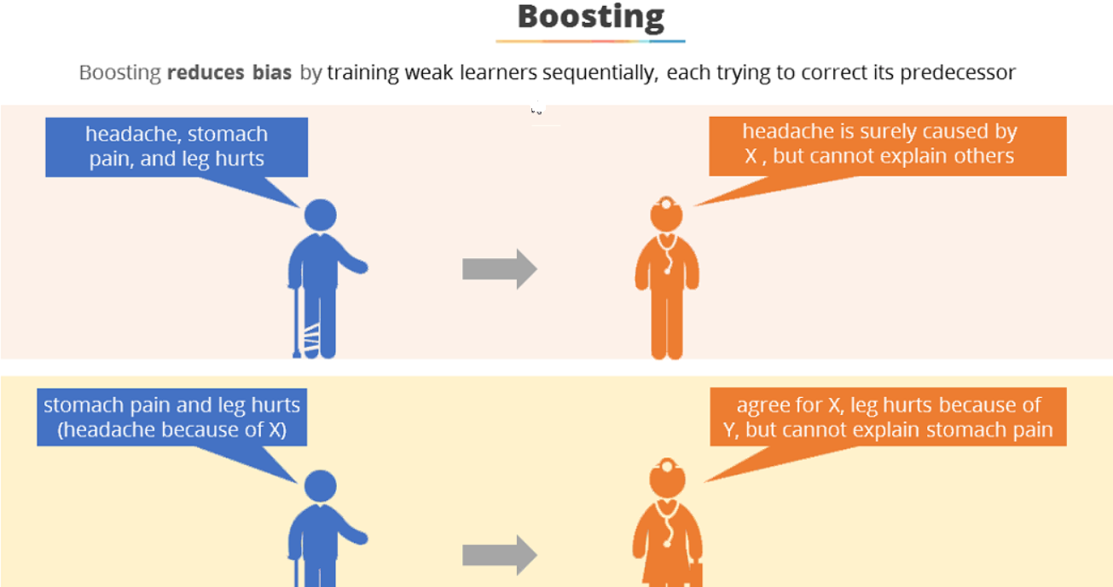

Slide 18
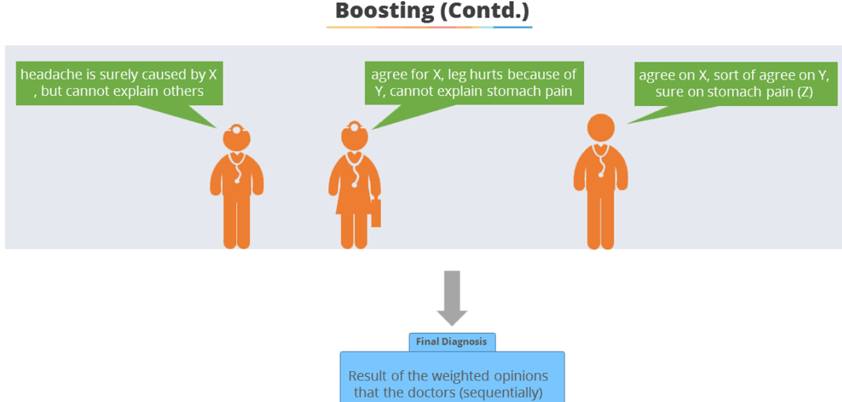

Slide 19
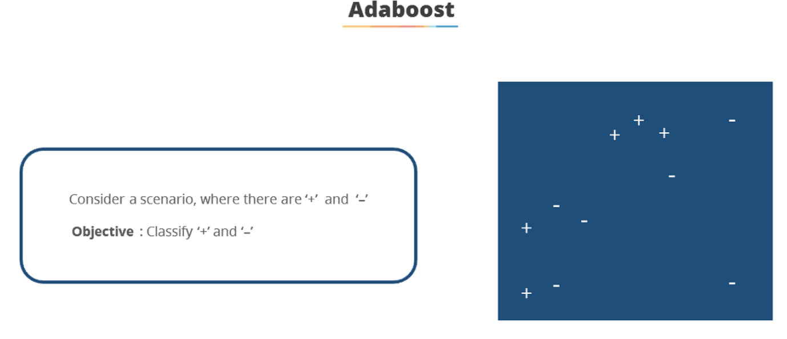

Slide 20
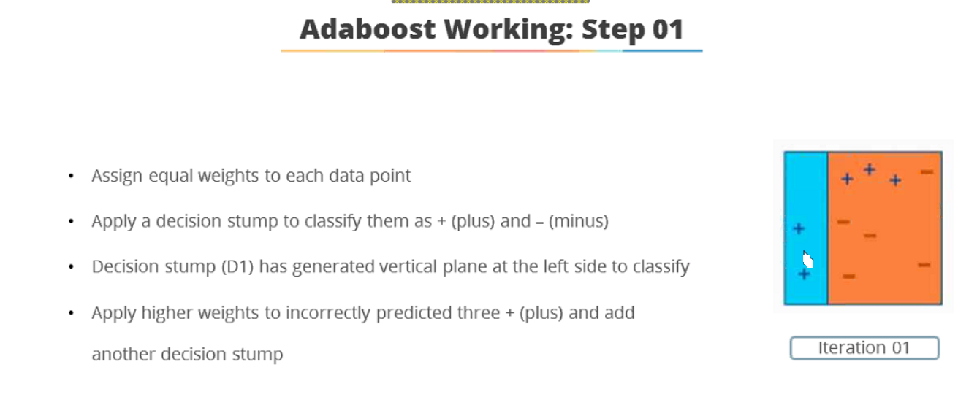

Slide 21
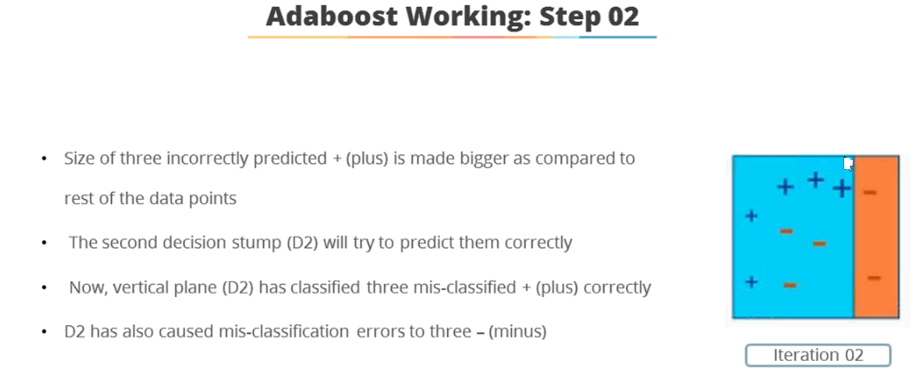

Slide 22
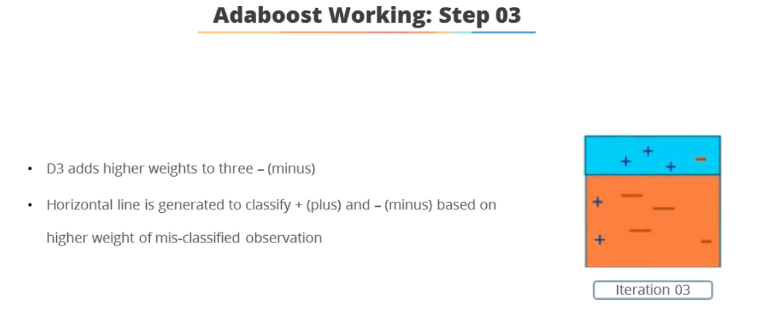

Slide 24
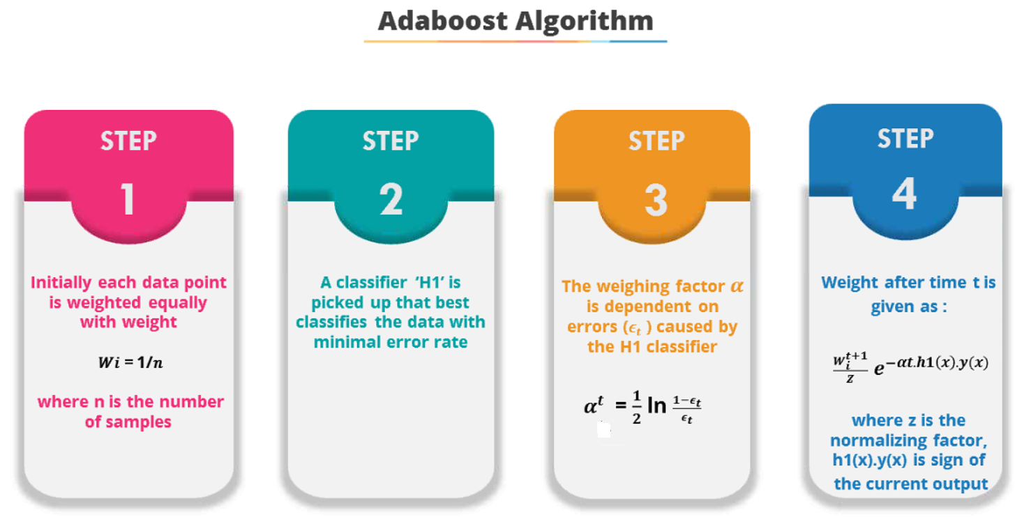

Slide 26
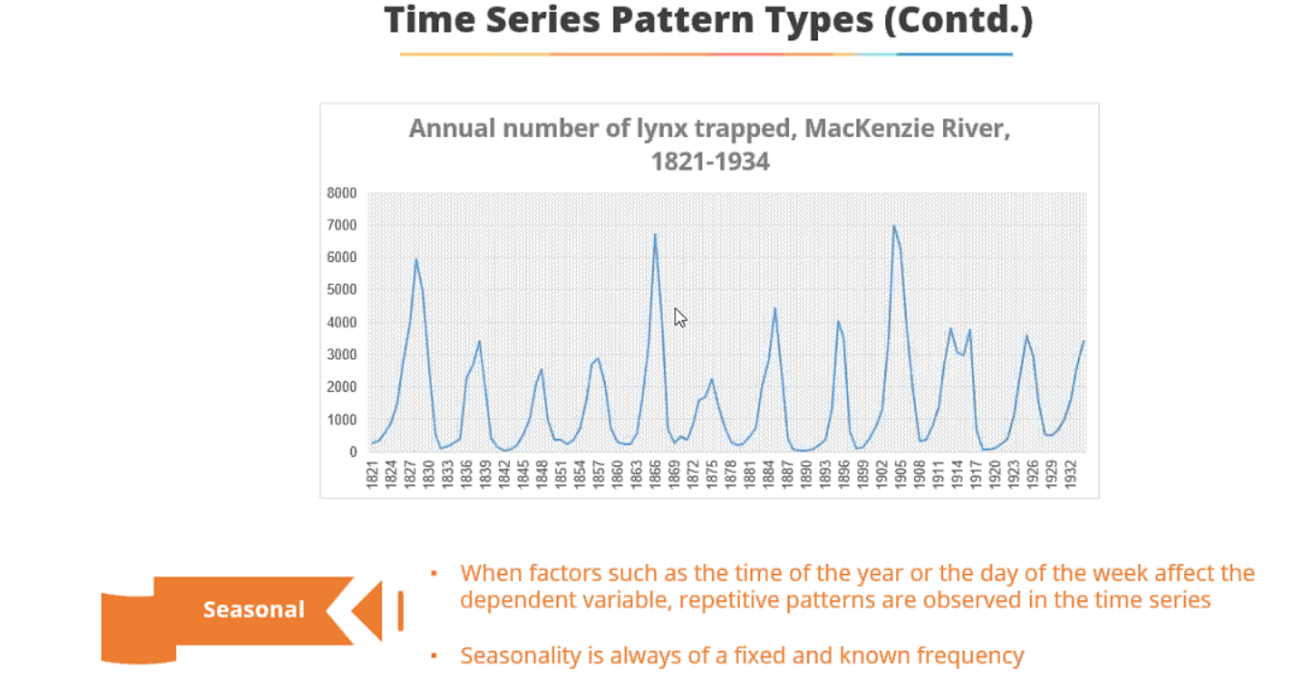

Slide 27
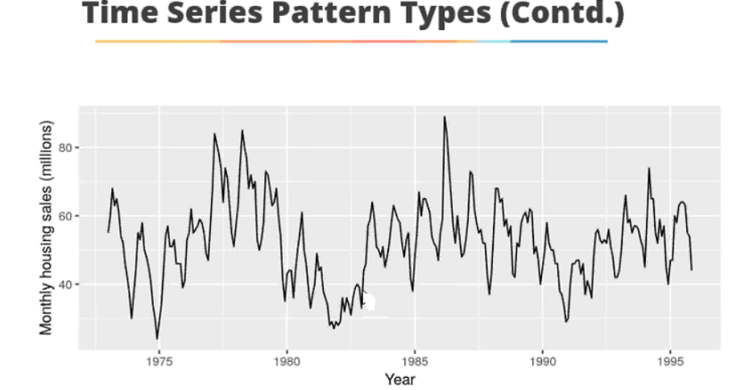

Slide 28
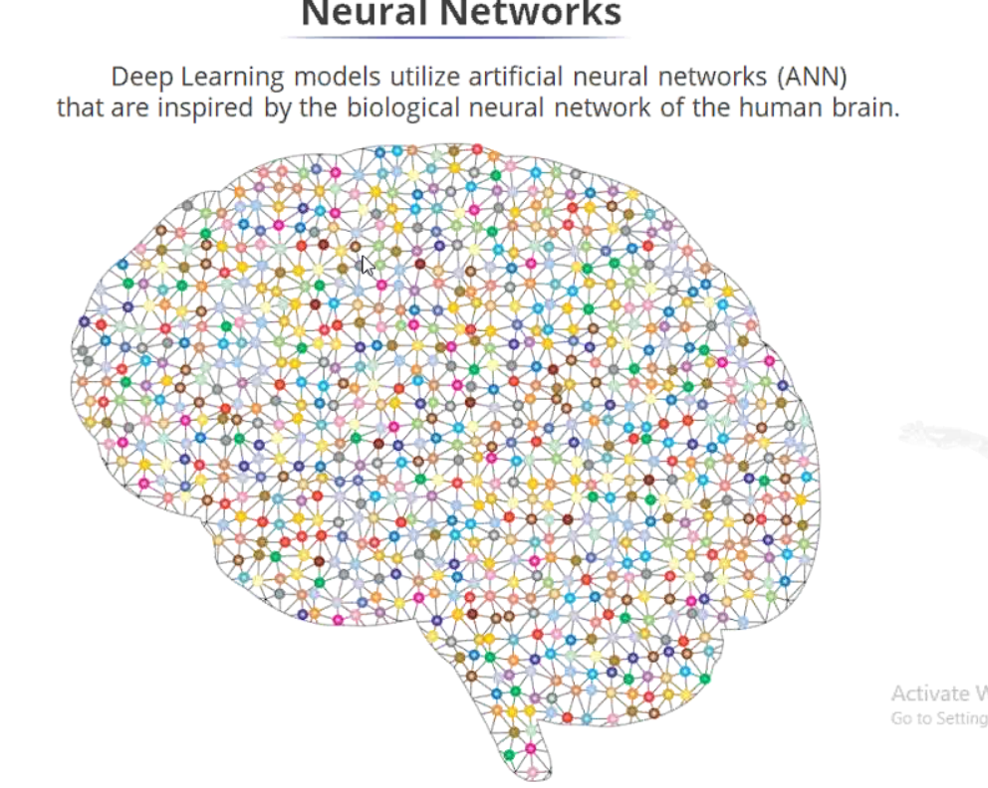

Slide 31
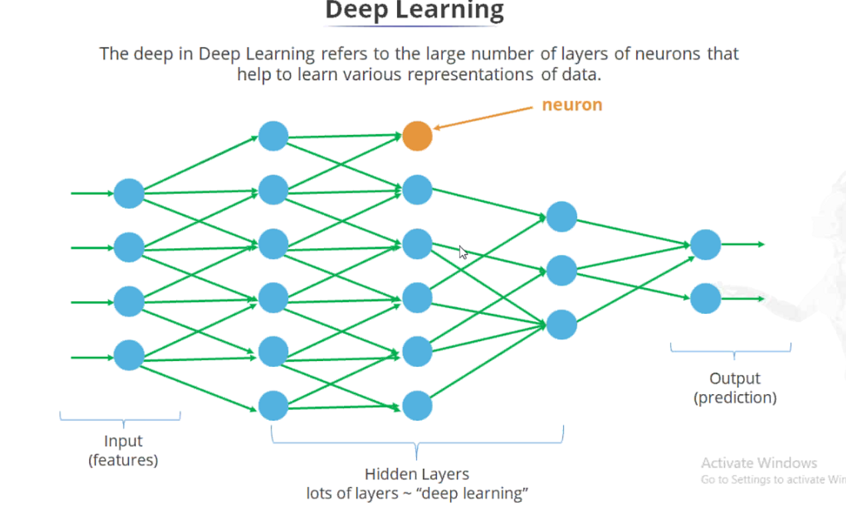

Slide 35
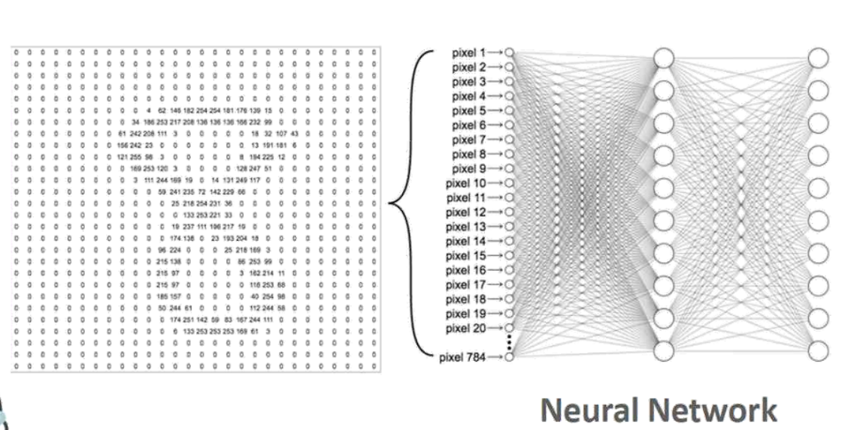

Slide 36
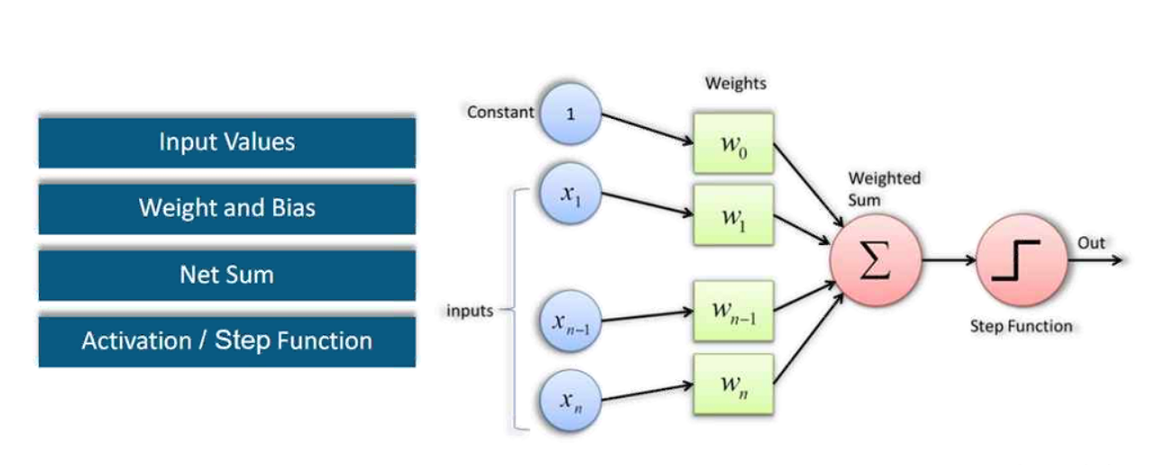
Components of Perceptron

Slide 37
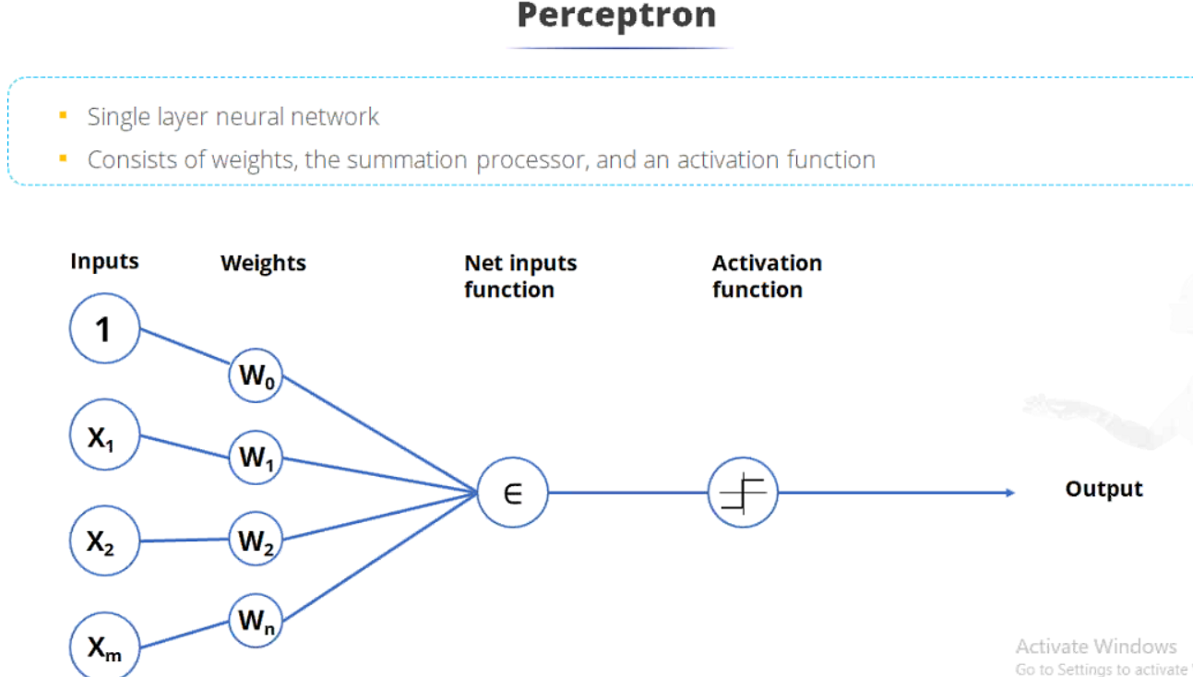

Slide 39
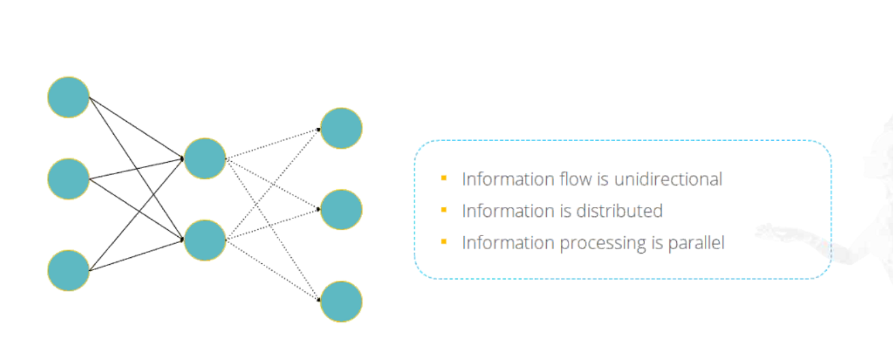
Feedforward Network

Slide 40
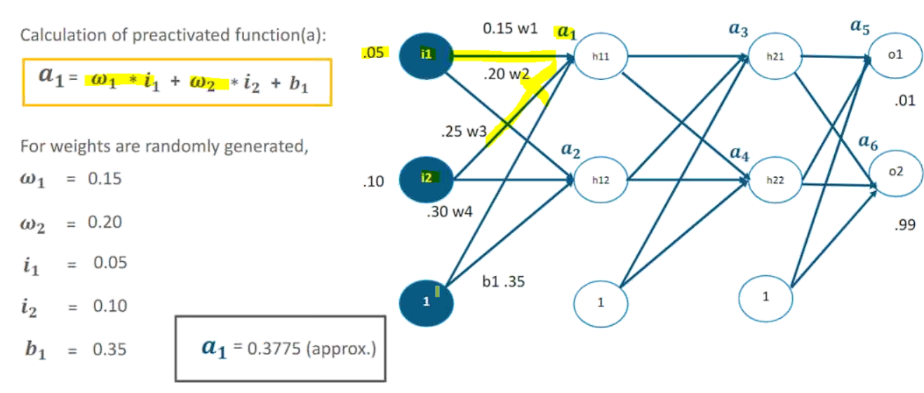

Slide 41
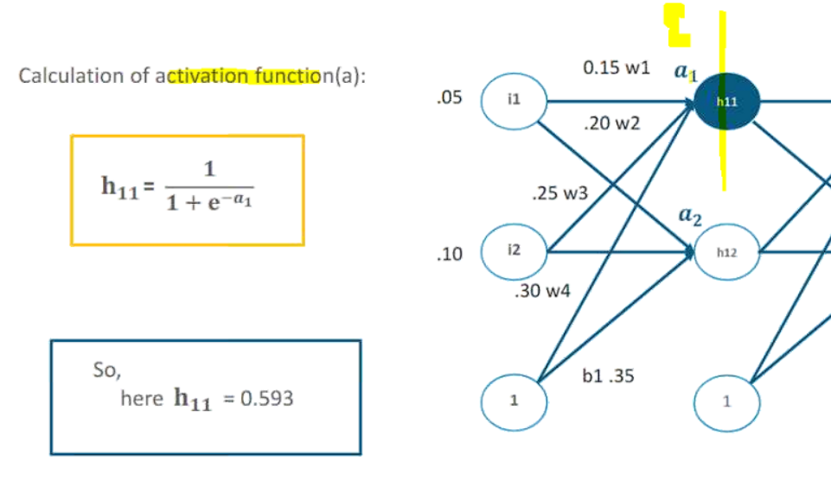

Slide 46
